Slide 1
PROJECT INTRODUCTION
Project Name: GNE114 4200 Static UPS
Objective- Export Sales team required Static UPS 3300W with 48V battery bank and Some new different looks like New Bezel and Graphical LCD with Multi color.
Scope- Increase Load capacity of 3.5KVA System, Change LCD and Chassis.
Measurement Goals - Schedule Variance:±20%,Product Defect Density:0.10±0.02,Project’s Process Defect Density:0.20±0.02,BOM COST: 14000±10% INR
Link to Project Data : http://10.141.1.9:8080/svn/HKVA_inv/GNE114
Team Size: 11 Nos.
Effort Size: 185 hrs.
Time Line : 13-9-2022 to 05-11-2022
Actual Scheduled Start to Finish Date: 13-9-2022 to

Slide 2
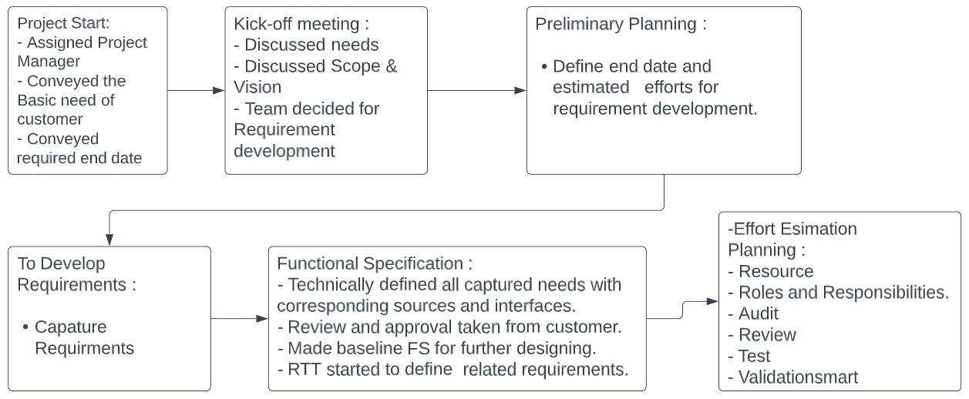
PROJECT FLOW

Slide 3
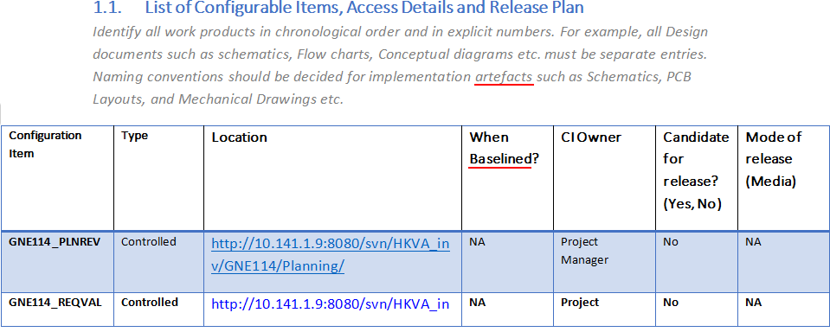
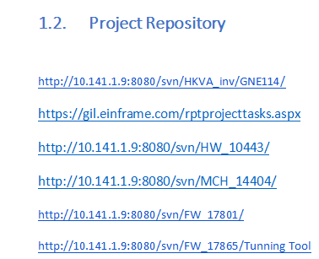
Configuration Management
CI List in Project plan contains items list which placed under configuration management, where we mentioned location, owner, baseline or control and release or no release against each items. List of Configurable Items, Access Details and Release Plan
Project repository at SVN Server used to perform version control of related artefacts.

Slide 4
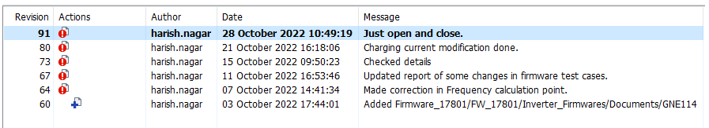
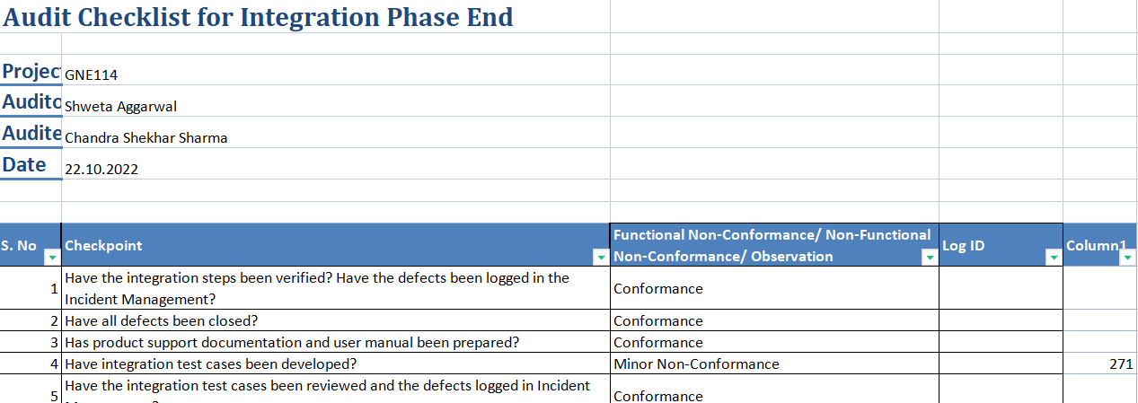
Configuration Management
Channge in Firmware design during Integration Testing . Version History at SVN Server.
Audit Checklist contains configuration audit related audit points that audited, section CM of each phase.
Audit Log showing configuration audit done.

Slide 5
PROJECT FLOW
Design:
- Collected and Study reference designs.
- Identified modules in each verticals.
- Identified alternate solutions in each modules.
- Select one solution out of corresponding alternate solutions
DAR :
- Due to further nonavailability of Driver IC IR2110 , take to alternate IC UC27712 and TLP350.
- Based on DAR applying criteria, selected IC TLP350.
- Applied PUGH matrix based weighted evaluation to select one solution.
Design:
- In hardware schematic prepared.
- In firmware flow chart prepared.
- In mechanical block diagram prepared.
- Review and close all defects of design
Implementation :
- In hardware PCBs prepared.
- In firmware coding done.
- In mechanical 2D and 3D drawings prepared.
- Review and approved design and implementations, as Baseline.
- RTT update
- Send to vendor to get physical modules.
Module Testing :
- Prepared module test cases and reviewed.
- Did module testing accordingly.
- Prepared interfaces and integration steps.
- Prepared integration test cases and reviewed.
- Prepared user support documents.
- RTT update

Slide 6
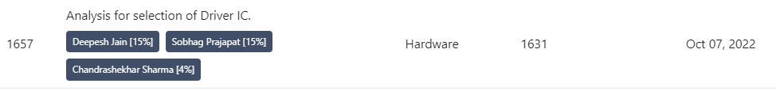
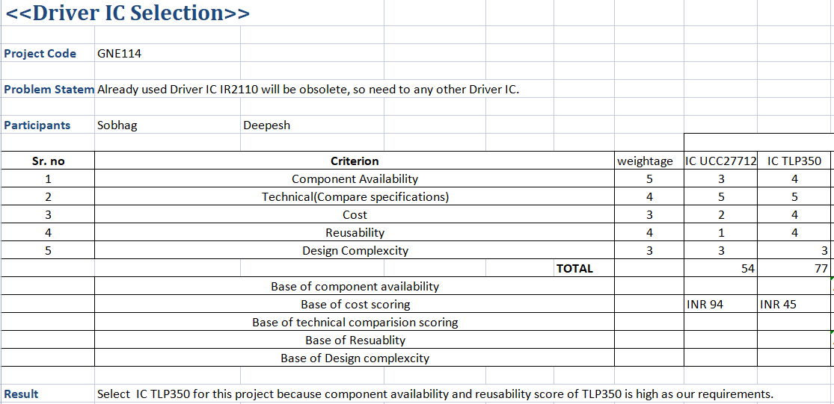
Decision Analysis and Resolution (DAR)
Add task in Project Plan defined when we follow DAR and defined team .
Defined evaluation method i.e. PUGH Matrix. GNE114_DARGEN
DAR Sheet where criteria defined. GNE114_DARGEN
DAR Sheet where defined alternate solutions, evaluation method.GNE114_DARGEN
DAR Sheet where alternate solutions evaluate and select using criteria and methods. GNE114_DARGEN

Slide 7
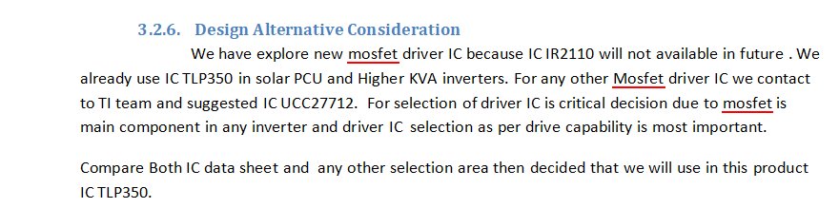
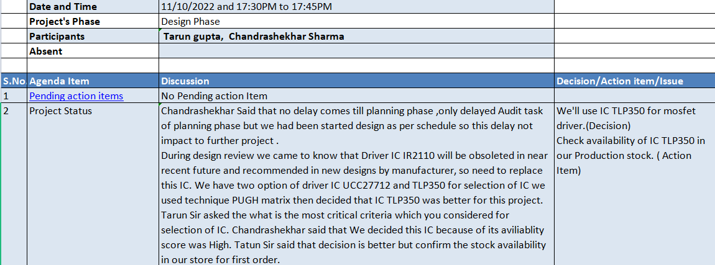
Decision Analysis and Resolution (DAR)
Hardware Design Document section Design Alternative Solution defined where we apply DAR. GNE114_HDWDSN
Approval comments by decision maker authority. MOM

Slide 8
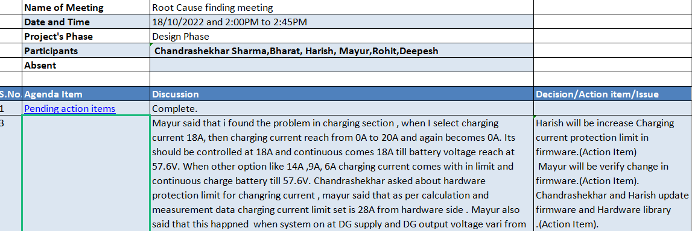
Root Cause Analysis : Integration Testing Defect
The Problem identified during Integration testing.Incident Managment
Make team and add task in plan for root cause analysis.Project Plan
Discussion with team for findout the root cause .MOM(RootCause Analysis)

Slide 9
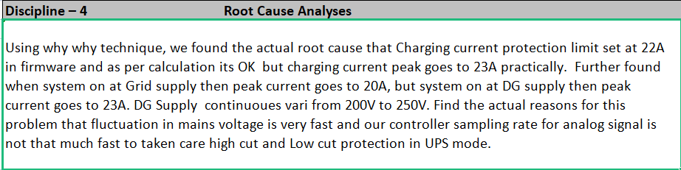
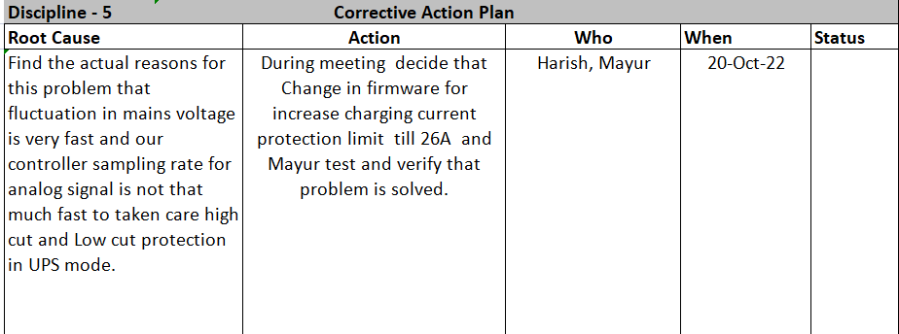
Root Cause Analysis : Integration Testing Defect
8 D CAPA based template GNE114_ROCSAN was used for root cause analysis of this selected outcome with team.
Corrective action for this problem change in Firmware design and code. Verify to impact of change during testing.Containment action identified that update in firmware library and incident proposed to approved learnings. GNE114_ROCSAN .

Slide 10
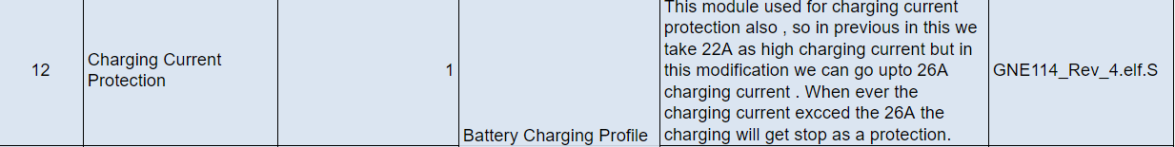
Root Cause Analysis : Integration Testing Defect
Approved Learnings
Master firmware Library

Slide 11
PROJECT FLOW
Integration :
- Interfaces considering mentioned CTQs
- Implement define Integration steps
- Integration Testing
- Ensured risk mitigated by taking mitigation plan.
- Product Integrated and ready for validation
- BOM cost calculate.
Validation :
- System test cases prepared to make sure required environment.
- Review the system test cases
- System Testing (Validation) to validate requirement vs product.
Release :
- According to configuration management plan collect all to be release outputs from corresponding version control repository.
- List out these design outputs with their latest versions.
- Made release note and review.
- Project released with the release note.
Closure :
- Project learning's captured with team and log in corresponding project learning log of share point.
- Make TDP and mentioned in closure report.
- Review and audit the closure report.
- Intimate all team members that project officially closed, and you are relieve from this project.

Slide 12
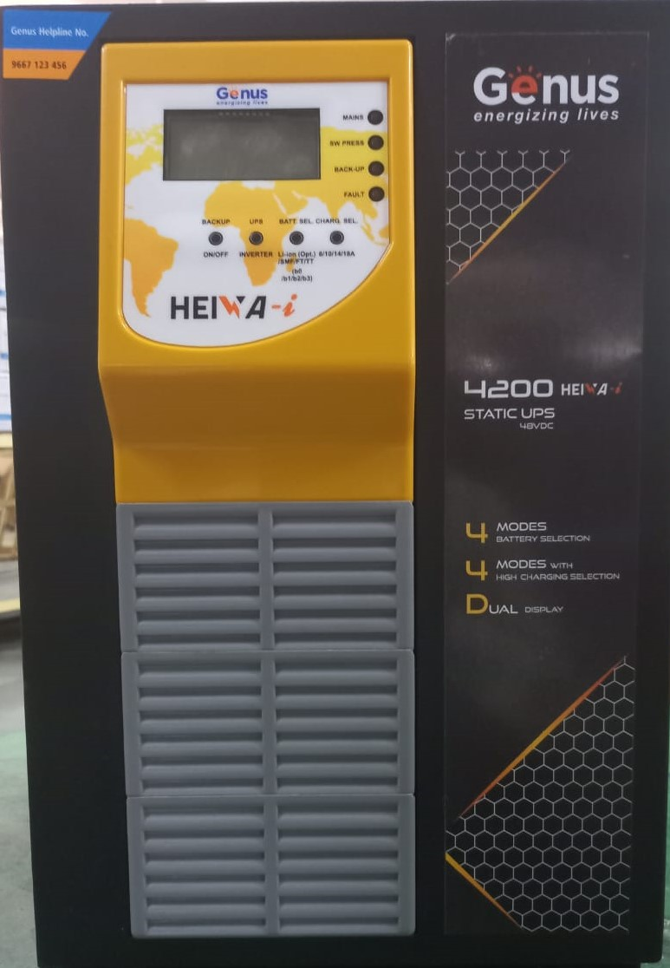
PRODUCT PICTURE
Release Note contains records of all release configuration items.
Closure Report contains records of all configuration items

